Slide 1
Light Rail’s Impact on Crime in Charlotte, NC
Jiang Jiang
Sthanu Ramakrishnan

Slide 2
Agenda
Background
Findings
Conclusion

Slide 3
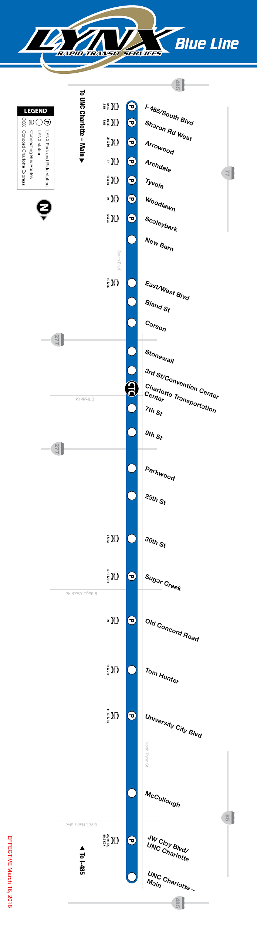
Background
LYNX Blue Line
1st light rail service in Charlotte region
9.6 + 9.3 miles long
15 + 11 stations from ​I-485 at South Boulevard to UNC Charlotte
9,700 weekday trips projected as the first-year ridership in 2007-08
25,500 weekday trips ridership in 2019
https://charlottenc.gov/cats/rail/lynx-blue-line/Pages/default.aspx
Notes:
Light rail service operated in 15 stations from I-485 to 9th street from 2007.
From 9th Street to UNC Charlotte, the service was extended in 2018.

Slide 4
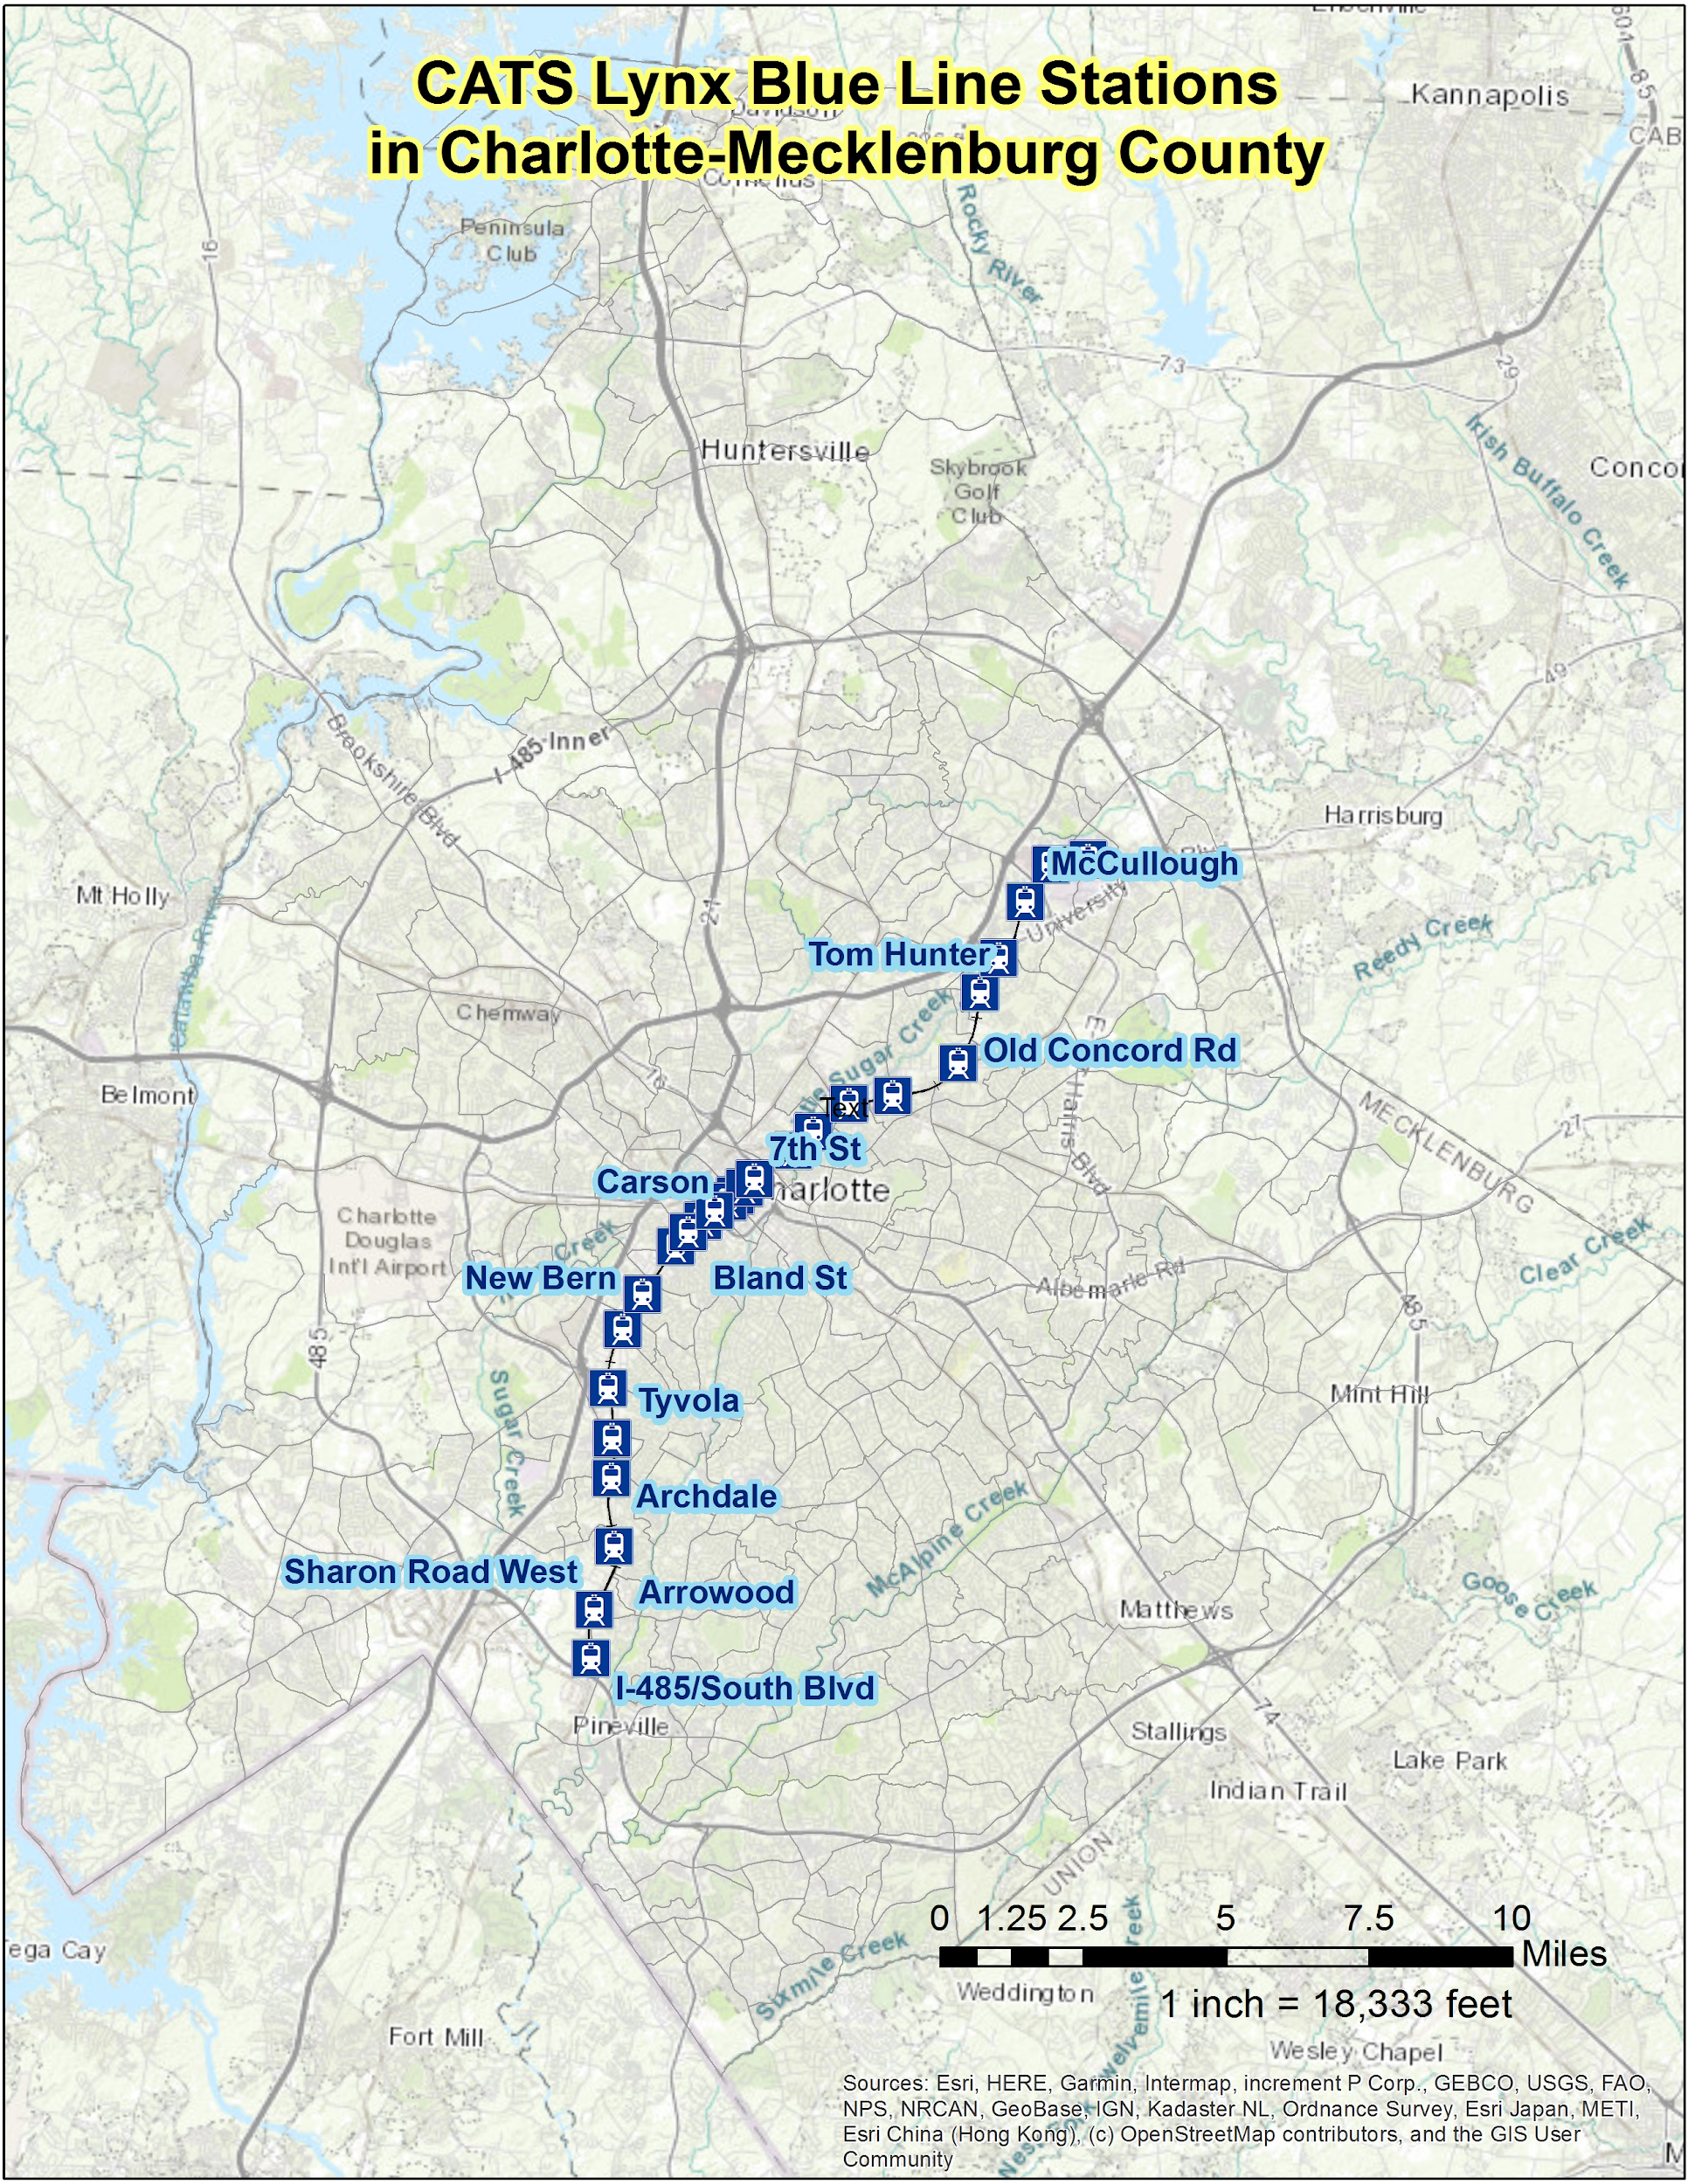
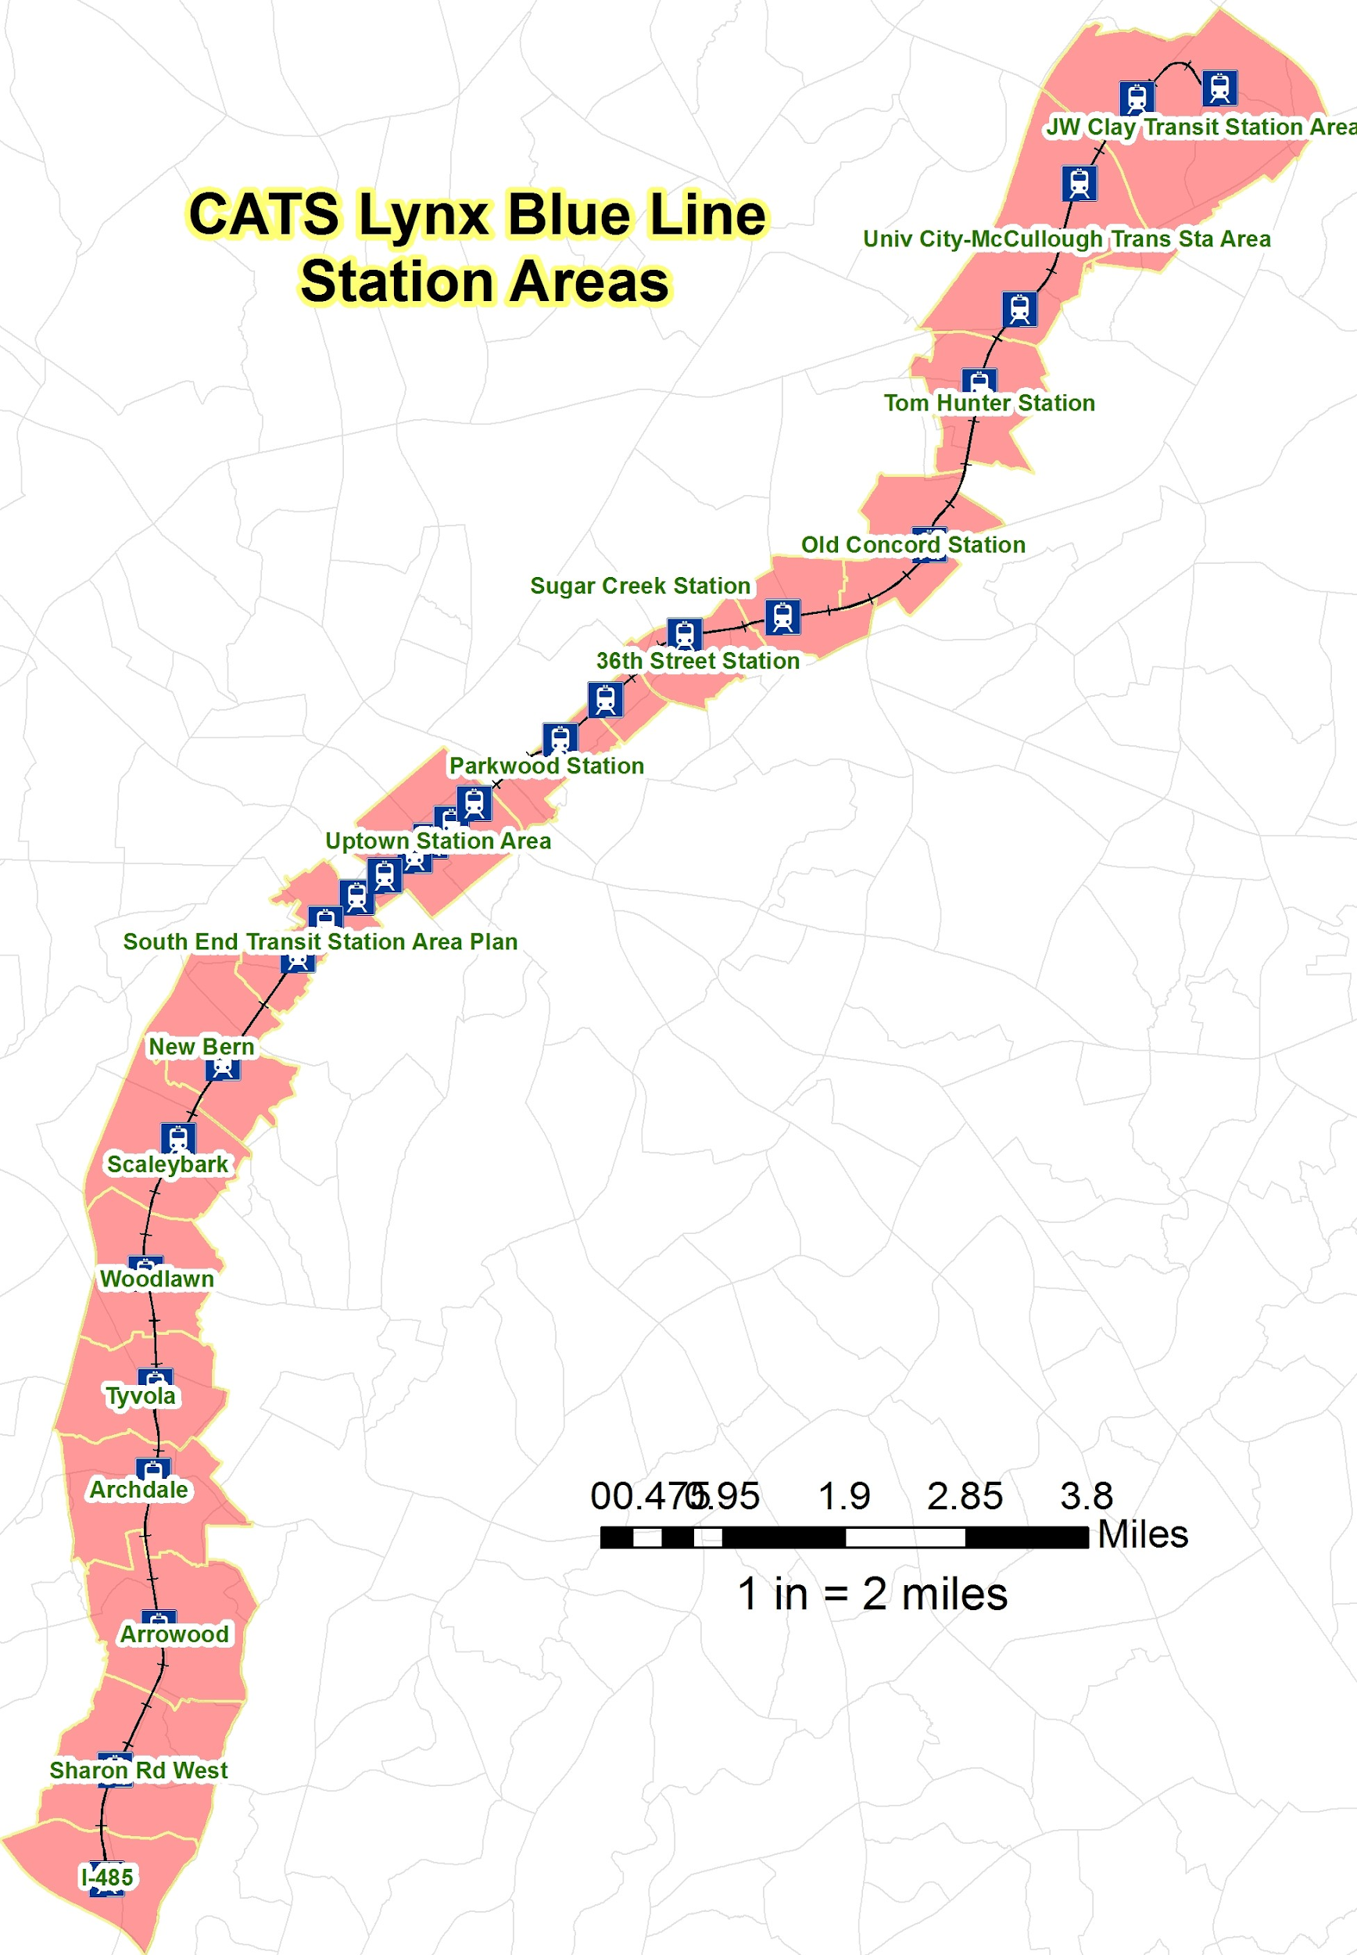
Notes:
This is how the Blue line travel along the geography of Charlotte. From Southwest to Northeast through the city.
Different location has different station area set my the Charlotte government. We have used these station areas as buffers to study the crime pattern.

Slide 5
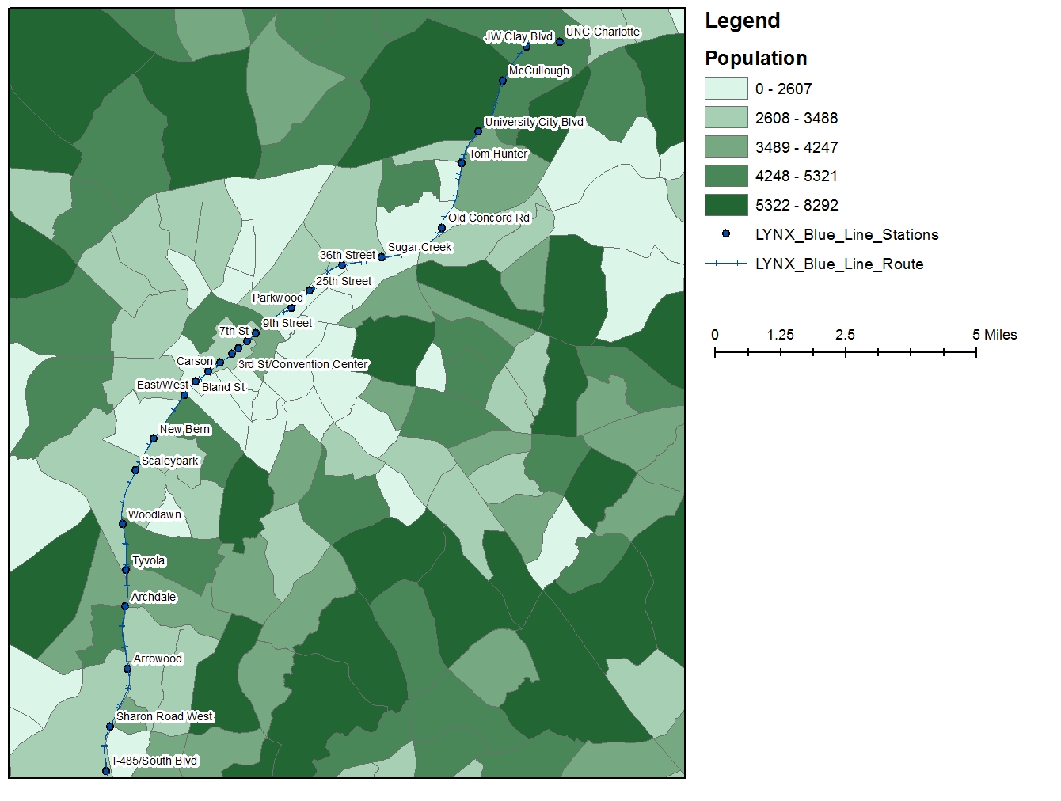
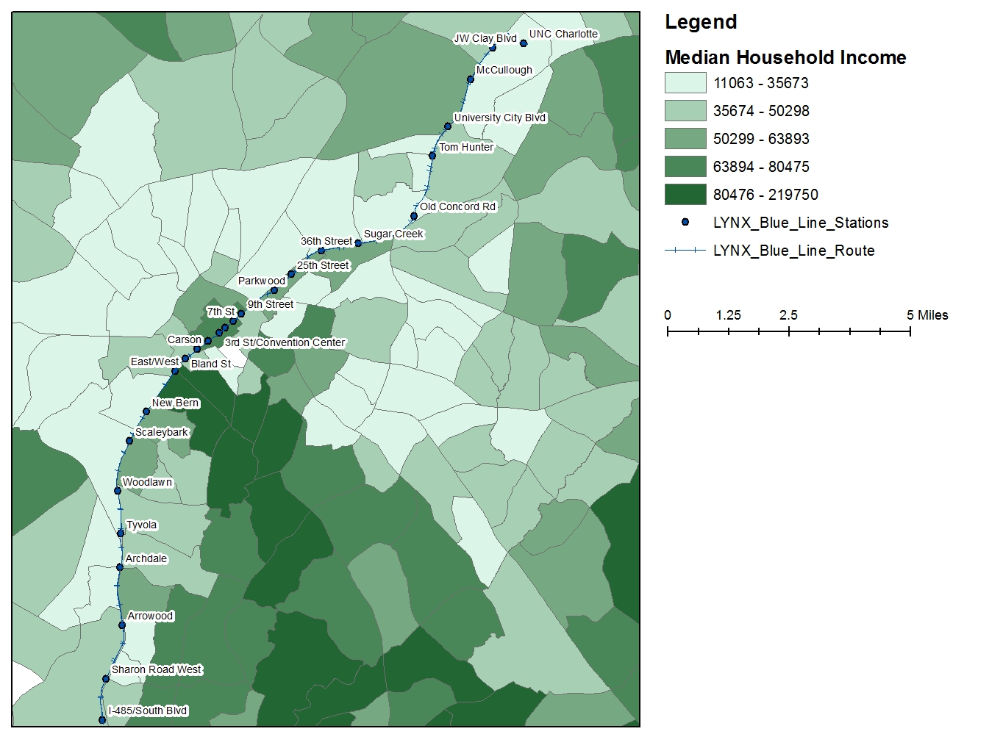
Demographics Around the Stations
Notes:
We can see that the population is more near the ends of the light rail line.
High income population lies in the south of the city.

Slide 6
Findings

Slide 7
Fishnet Size :
1000ft x 1000ft
Notes:
We had the crime data from 2005 to 2016.
We thought we would study about our buffer area around each station.
We joined the crime location to the Charlotte map and filtered to focus only on our study area.
We created a fishnet of 1000 sq.ft to see where the crimes are focused at a granular level.
This entire animation was created in ArcMap.
We see a decrease in crimes in 2009 before increasing again in 2012.
Comparing our study time period 2006 and 2008, since the Blue line was inaugurated in 2007. The crimes seem to increase in 2007 but we don’t see much change between 2006 and 2008.

Slide 8
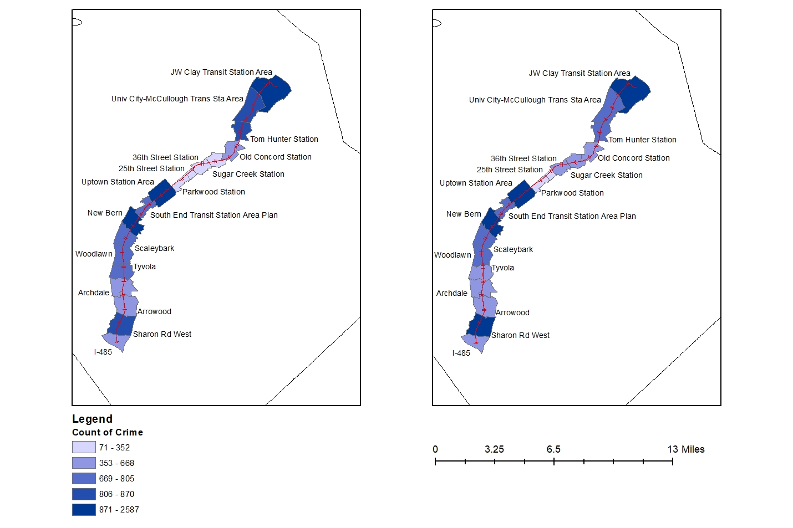
Total Crime Count in 2006 vs 2008
Notes:
The before and after images looks similar showing that crimes haven’t greatly changed after the inauguration of the light rail.

Slide 9
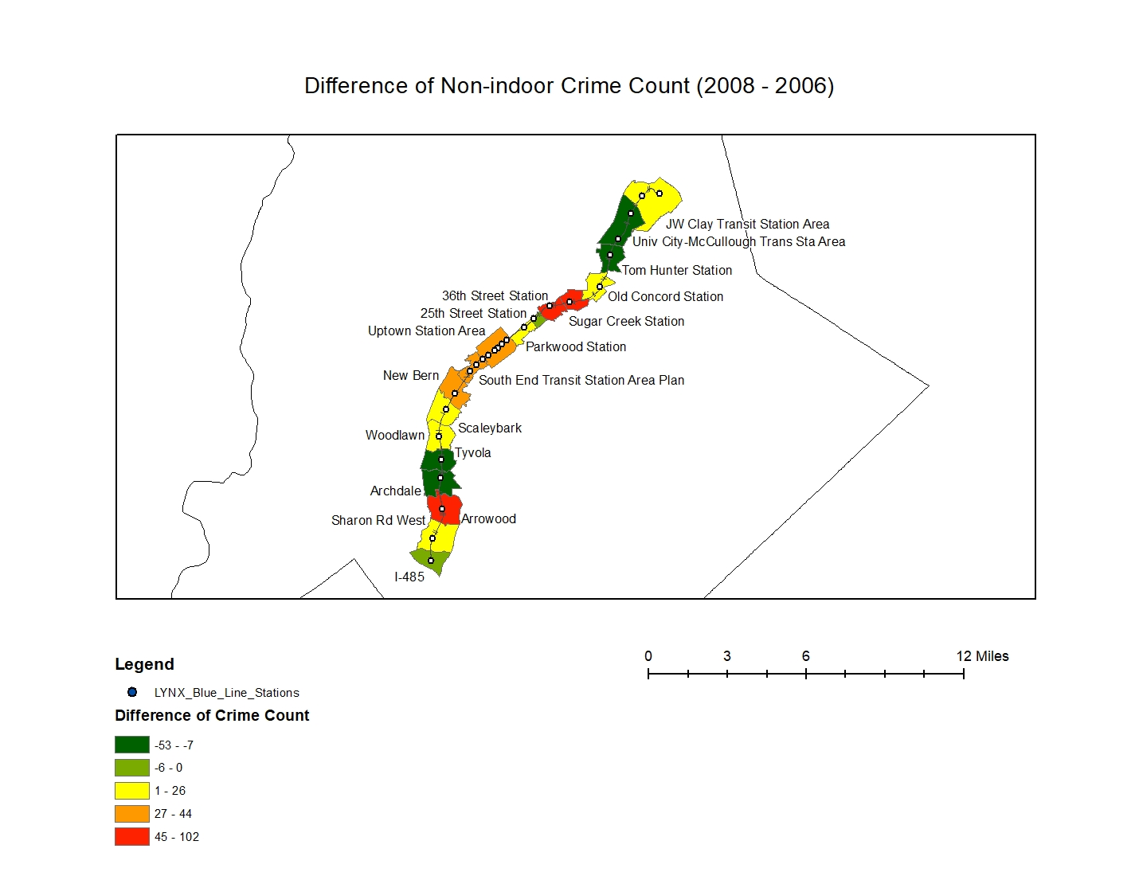
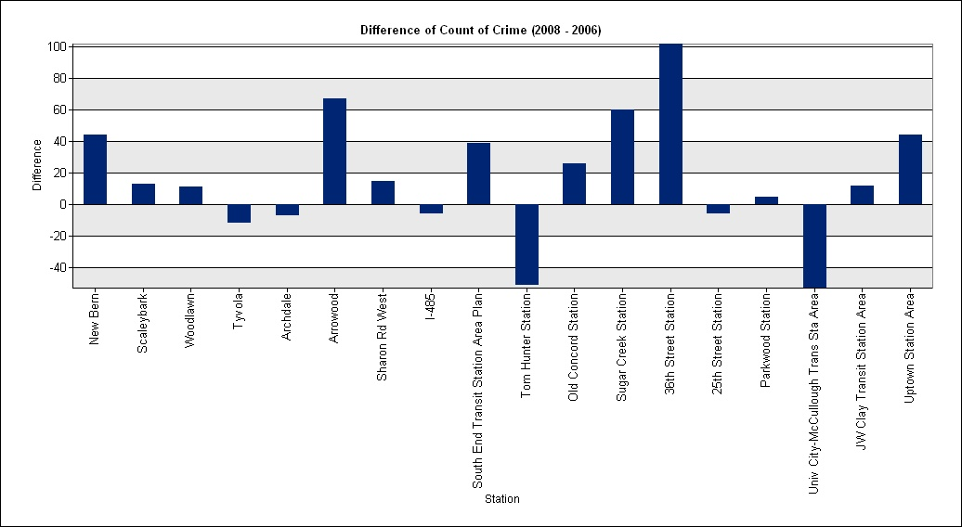
Total Non-indoor Crime Count in 2006 vs 2008
More increase than decrease
Especially for the stations that are open
Notes:
We are focussing on the outdoor crimes happening along the light rail route.
White shapes block the stations that were not open in 2007.
Green colour indicated crime has decreased in these areas and red indicated the crime has increased in these areas.
Crimes has increased near the Arrowood station and decreased near the Tyvola and Archdale stations.

Slide 10
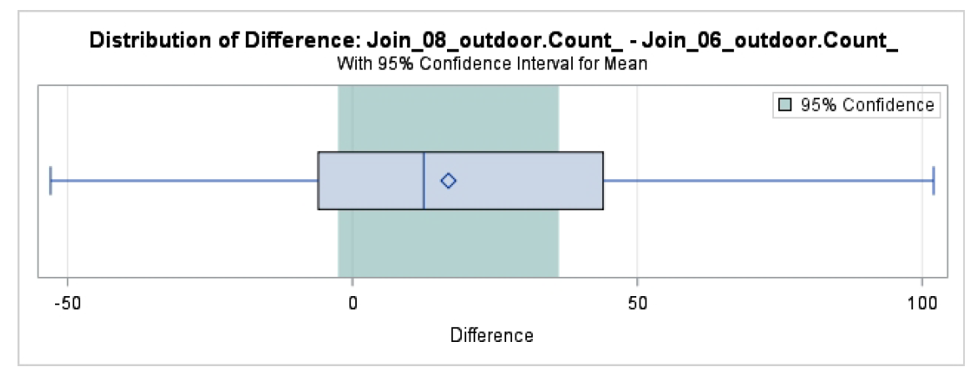
Paired t-test
“A paired t-test is used to compare two population means where you have two samples in which observations in one sample can be paired with observations in the other sample. One example of where this might occur is before-and-after observations on the same subjects.”
Crime slightly but significantly increased in 08 compared to 06. (SAS E Guide)
Source: http://www.statstutor.ac.uk/resources/uploaded/paired-t-test.pdf
Notes:
A paired t-test was conducted in SAS Enterprise Guide to determine if the difference between non-indoor crime count in 2006 and 2008 is statistically significant.

Slide 11
Crime Types in our Study
Affray
Aggravated Assault
Burglary/B&E
Curfew/Loitering/Vagrancy Violations
Damage/Vandalism Of Property
Drug/Narcotic Violations
Forcible Fondling
Indecent Exposure
Motor Vehicle Theft
Pocket-Picking
Prostitution
Purse-Snatching
Simple Assault
Statutory Rape
Theft From Motor Vehicle
Theft of Motor Vehicle Parts from Vehicle
Weapon Law Violations
Notes:
We considered the following crime types which we felt relevant to crimes along the light rail.
Affray - fighting in public places.
Aggravated Assault - causing serious body injury.

Slide 12
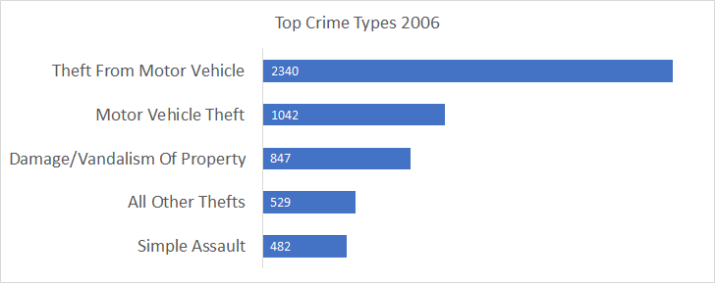
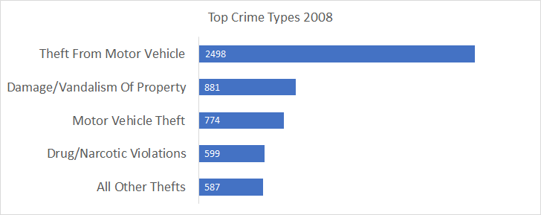
Top Crime Types in the Study Area (06 vs 08)
Top one crime is the same - Theft from Motor Vehicle
More Damage/Vandalism of Property. Less Motor Vehicle Theft
Notes:
Theft from Motor Vehicles seem to be the top crime.
And after the inauguration of light rail, Drug/Narcotic violations entered into the list of top 5 crimes.

Slide 13
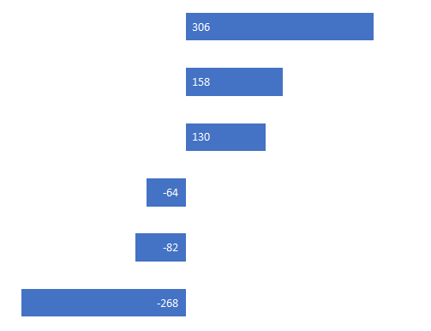
Crime Type Count Changes in the Study Area
Drug Equipment Violations
Theft From Motor Vehicle
Drug/Narcotic Violations
Burglary/B&E
Robbery
Motor Vehicle Theft

Slide 14
Top Crime Type Count 2006 vs 2008
Top Increase
Drug Equipment Violations +306
Theft From Motor Vehicle +158
Drug/Narcotic Violations +130
Top Decrease
Motor Vehicle Theft -268
Robbery -82
Burglary/B&E -64

Slide 15
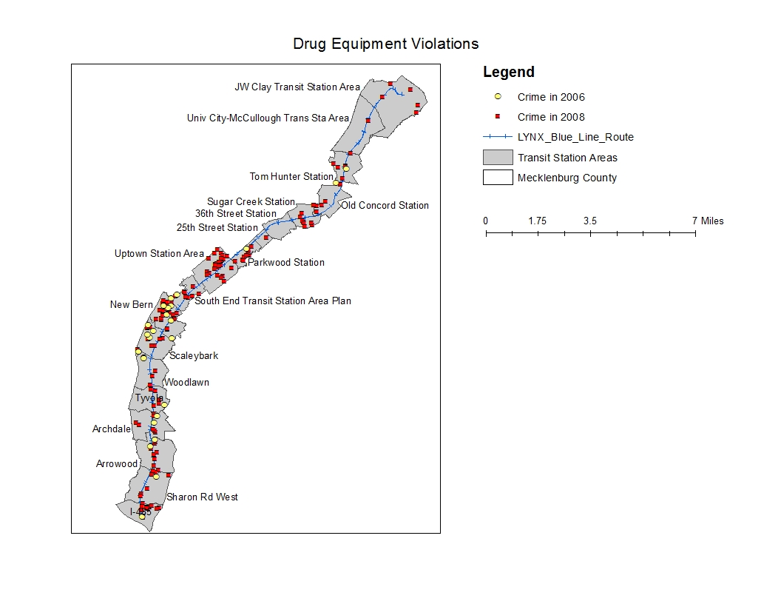
Drug Equipment Violations (+306)
2006: Clustered around New Bern, Scaleybark stations
2008: Along the blue line route and uptown area

Slide 16
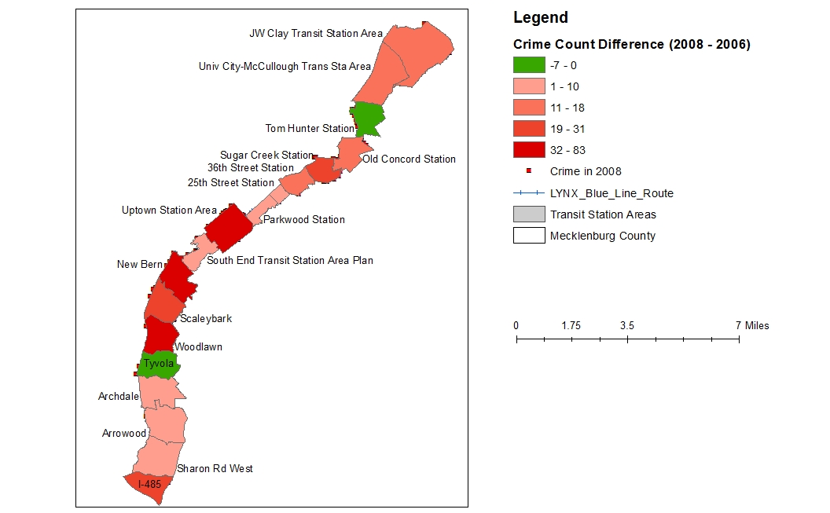
Drug/Narcotic Violations (+130)
Large increase in uptown, around Bern and Woodlawn stations.

Slide 17
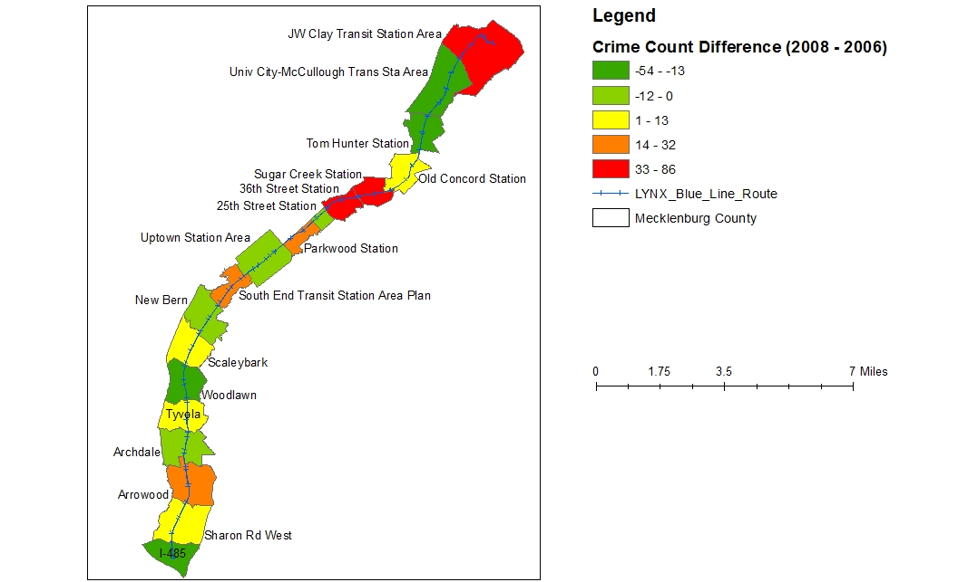
Theft From Motor Vehicles (+158)
JW Clay Transit Station Sugar Creek Station
(next to parking decks)
36th Street Station
(next to NoDa)

Slide 18
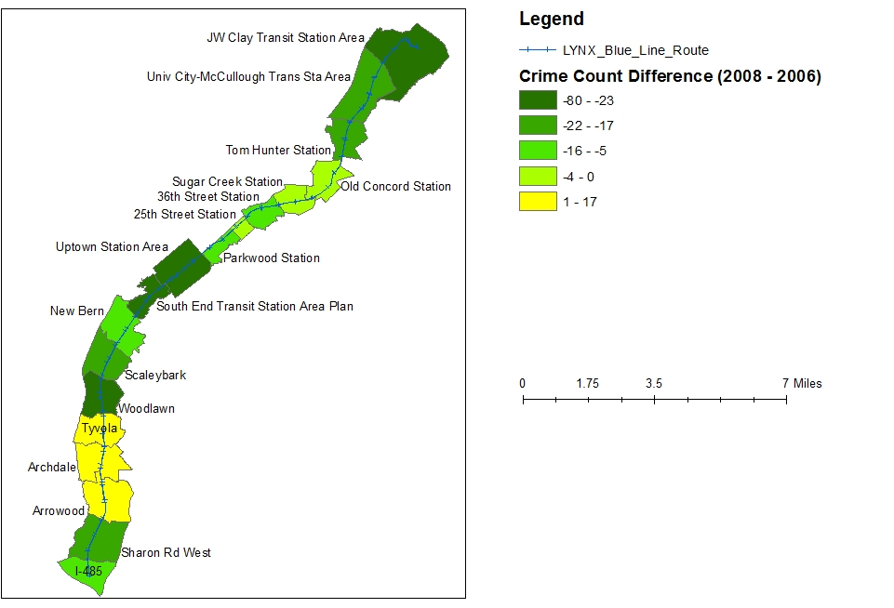
Motor Vehicle Theft (-268)
Mostly decreased in JW Clay Transit Station Area, uptown and Woodlawn station Area.

Slide 19
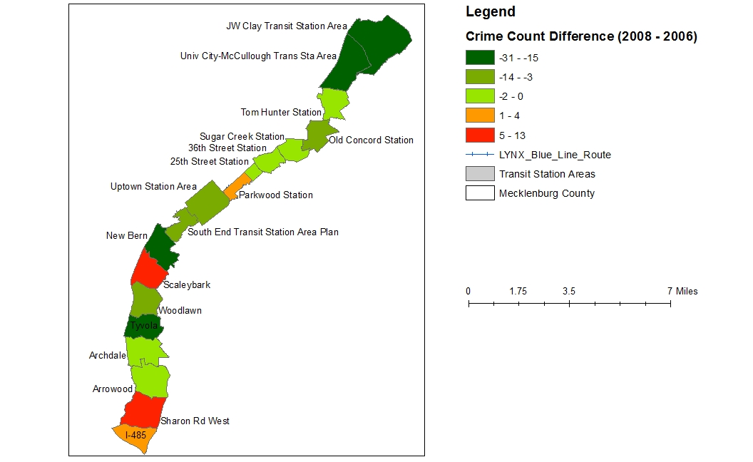
Robbery (-82)
Mostly decreased in university area, New Bern and Tyvola.
Only increased in Sharon Rd West station and Scaleybark station.

Slide 20
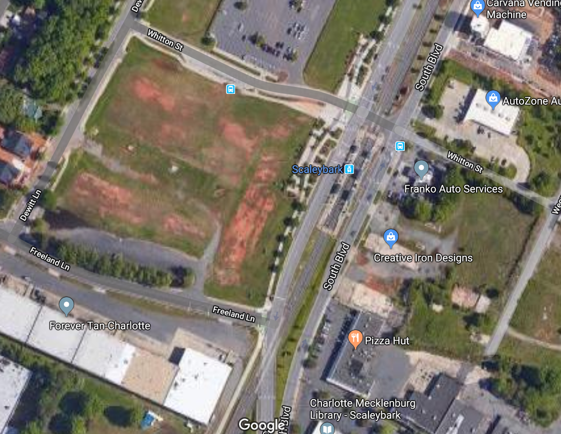
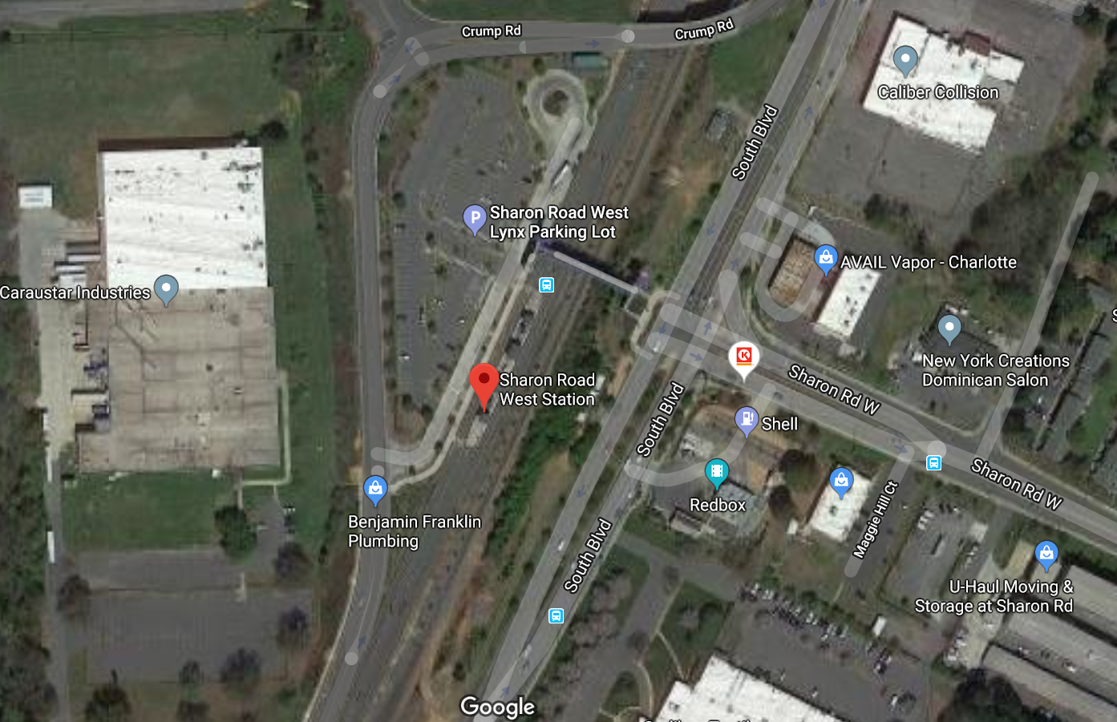
Scaleybark station
Vacant land
Sharon Road West Station
Industrial area
Similar to the findings in a study in NY subway stations (Clarke, Belanger, and Eastman, 1996)

Slide 21
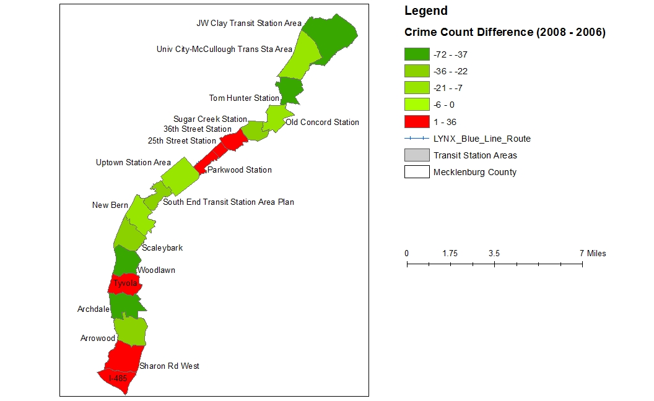
Burglary/B&E (-64)
Mostly decreased

Slide 22
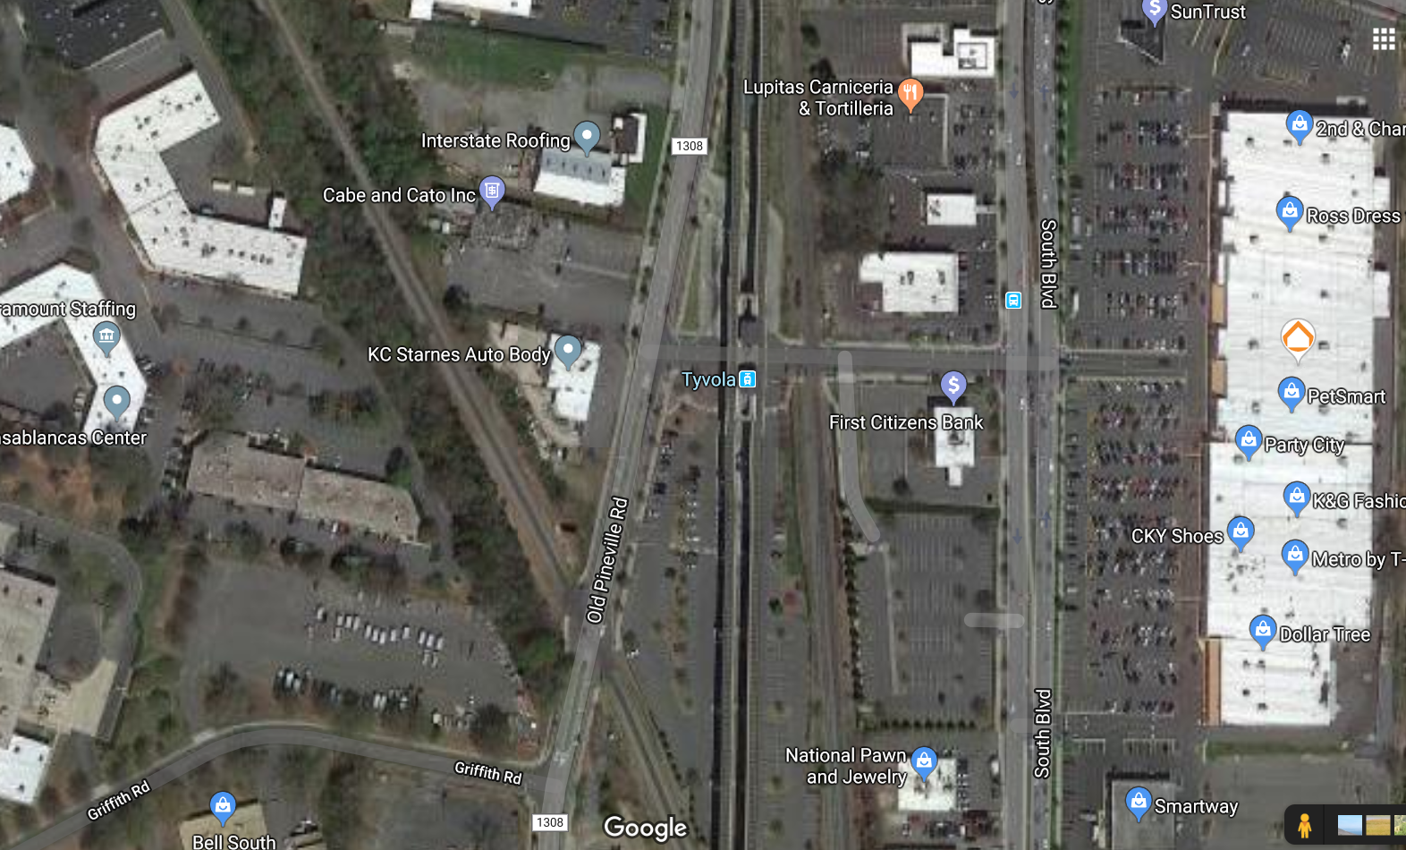
Tyvola Station
Multiple financial institute + shopping center
SunTrust
ATM
Shopping Center
First Citizen Bank
Pawn & Jewelry

Slide 23
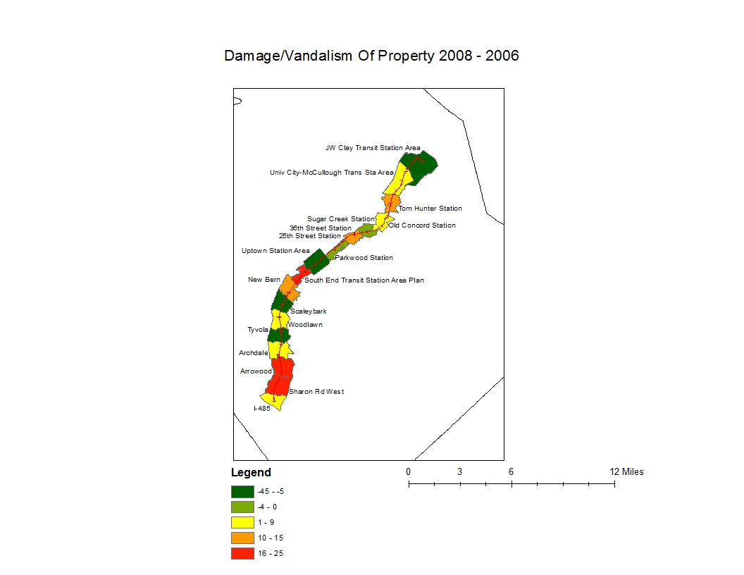
Danger/Vandalism of Properties
Most severe increase:
South End
Arrowood + Sharon Rd

Slide 24
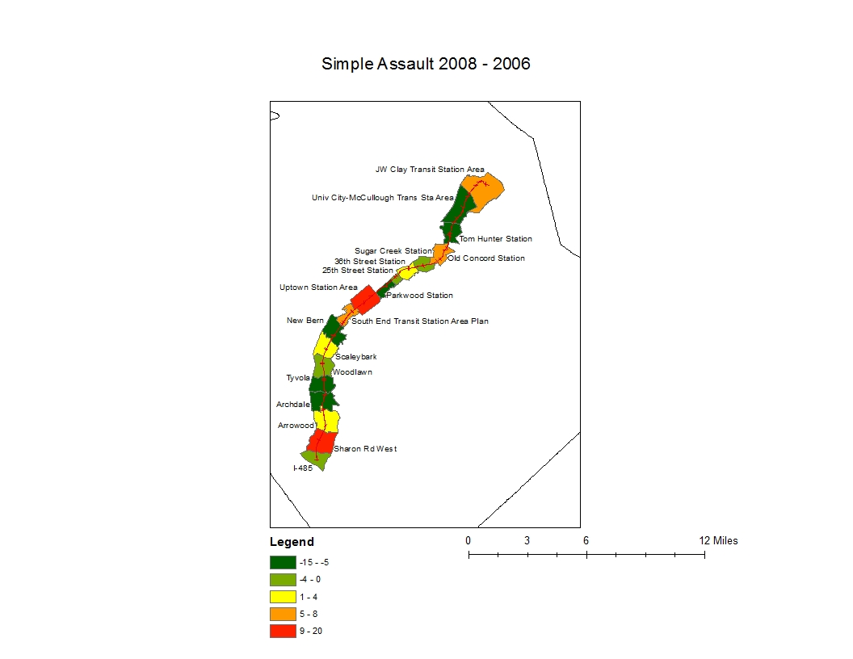
Simple Assault
Severe increase:
Uptown
Sharon Rd

Slide 25
Conclusion

Slide 26
Conclusion
Light rail brings changes to the most common crime types
Light rail has different impact on different types of crime.
Drug related crimes increased.
Light rail has different impact on different stations.

Slide 27
Suggestion
Increasing the force on preventing drug related crime along the stations
More security in the parking lots and especially, parking decks, next to the transit stations
Better station and parking lot design
-> eliminating the hiding spots
-> increasing the visibility via sufficient lighting

